Slide 1
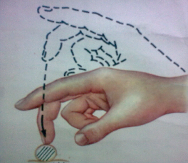
Inquiry of patients with gastro-intestinal diseases. General examination. Superficial & deep palpation of abdomen.

Slide 2
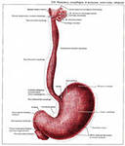
Complaints in patients with esophageal diseases
Dysphagia
Esophageal vomiting
Regurgitation
Sialorrhea
Putrificient odor
Heartburn
Esophageal bleeding

Slide 3
Dysphagia (dysphagia) – difficult passage of food via esophagus.
Causes:
Esophagus complaints
Organic narrowing of esophagus
Esophagus tumor
Cicatricial stenosis
Foreign body in esophagus
Compression of esophagus by aortic aneurysm or mediastinal tumor
Functional narrowing of esophagus
Neurosis
Disorders in esophagus innervation

Slide 4
Distinguishing signs of organic and functional narrowing of esophagus
Esophagus complaints
Organic narrowing | Functional narrowing
Periodicity of dysphagia | - Constant - Temporary restoring of passage of food in tumor disintegration | - Paroxysmal - In agitation and и hasty feeding
Passage of food | - At first it’s difficult for solid food, but later for liquid | - Solid food is passing better than liquid food

Slide 5
Distinguishing signs of esophageal gastric vomiting
Esophagus complaints
Esophageal vomiting
Occurs without nausea
Feeling of retained food behind the sternum
Includes non-digested food
Contains neither HCl nor pepsin
Gastric vomiting
Precedes by nausea, sometimes by hypersalivation
Contains residuals of digested food
Sourish odor of vomit mass
Acid reaction

Slide 6
Pain (dolor) in esophageal diseases feels along all esophagus with irradiation into interscapular space
Esophagus complaints
Causes:
Esophagitis (inflammation of esophagus’s mucose)
Burns of esophagus
Esophageal achalasia
Hernia of esophageal opening (of diaphragm)

Slide 7
Other complaints of patients with esophagus diseases
Esophagus complaints
Regurgitation - return of part of swalloed food into the mouth (neurosis, cardiospasm)
Hypersalivation - esophagitis, cicatricial narrowing and cancerous stenosis of esophagus
Putrificient odor - foul breath cancer tumor, congestion & decomposition of food in cardiospasm
Heartburn (pyrosis) - painful burning sensation behind sternum due to regurgitation of gastric contents into inferior portion of esophagus

Slide 8
Esophageal bleeding
Causes:
Esophagus complaints
Esophageal ulcer
Injury by foreign body
Disintegration of tumor
Bleeding of dilated esophageal veins
Mallory-Weiss syndrome

Slide 9
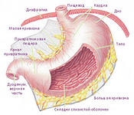
Complaints in gastric diseases
1. Dyspeptic complaints:
  Poor appetite
  Perverted appetite
  Perverted taste
  Eructation
  Heartburn
  Nausea
  Vomiting
2. Pain
3. Gasrtic bleeding

Slide 10
Poor appetite
Gastric complaints
Hyporexia
up to loss of appetite (Anorexia)
Acute gastritis
Gastric tumor
Citofobia – abstention from food for fear of pain in gastric ulcer
Increase of appetite
Duodenal ulcer
Perverted appetite
Achlorhydria (gastric anacidicity)
Pregnancy
Aversion to meat
Gastric tumor

Slide 11
Eructation – loud uprise of wind from stomach or esophagus
Gastric complaints
Regurgitation of food (Regurgitatio)
Regurgitation of wind (Eructatio) - aerophagy
Smell of bitter oil – abnormal fermentation in decrease of gastric motor activity
Rotten smell - with pyloric stenosis
Acid odor - with hypersecretion of gastric juice
Bitter smell - when throwing bile from duodenum into the stomach (duodeno-gastral refluxe); with increased acidity of gastric juice
Belching with a putrid odor - with hypo- and achlorhydria, stagnation with cancer of the stomach

Slide 12
Heartburn (Pyrosis) - burning sensation in the epigastric region
Causes:
Increased acidity of gastric juice
Gastroesophageal Reflux
Violation of the motor function of the esophagus, stomach and duodenum
Peptic ulcer
Cholecystitis
Esophageal hernia

Slide 13
Nausea (Nausea) - a reflex act associated with irritation of the vagus nerve, manifested by a feeling of pressure in the epigastric region
Often accompanied by pale skin, weakness, dizziness, sweating, salivation, hypotension, cold extremities, fainting state.
Causes:
Toxicosis of pregnant women
Kidney and liver failure
Cancer of the stomach, acute gastritis (after eating)
Circulatory disorders

Slide 14
emesis, vomitus
Vomiting mechanism:
Causes:
Nervous (central) - CNS diseases - CNS injuries
Visceral (peripheral) - Acute gastritis
- Stomach peptic ulcer
- Cholecystitis
Hematogenous Toxic - Chronic Renal Failure
- Poisoning

Slide 15
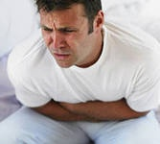
Pain (dolor) – stomach and duodenum
Localization of pain.
The nature of the pain.
The relationship of pain with taking
food.
Irradiation of pain.
Change in pain intensity after vomiting, eating, drugs, etc.
The relationship of pain with physical exertion.

Slide 16
Pain (dolor)
Spastic pains - arise mainly as a result of spasm of smooth muscles | Acute, paroxysmal, very intense, usually clearly localized with typical irradiation, weaken after antispasmodics. May be accompanied by vomiting, fever | Gastric colic (peptic ulcer), biliary colic, intestinal colic (irritation bowel), renal colic
Extansion pain - pain from stretching the walls of hollow organs and tension of their ligamentous apparatus | Dull, aching, low-intensity, usually spilled, without a clear localization and irradiation, often do not subside after taking antispasmodics | Flatulence, hyposecretory syndrome

Slide 17
Gastrointestinal bleeding
Causes:
peptic ulcer, stomach cancer,
polyp of the stomach, erosive gastritis
Manifestations:
bloody vomiting (haematemesis)
tarry stool (melaena)
Coloring of vomit:
the color of "coffee grounds" - with prolonged bleeding
scarlet color - when a large vessel is damaged

Slide 18
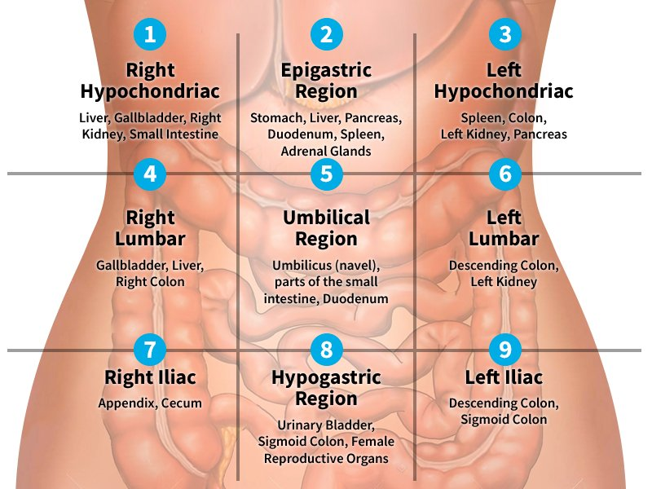

Slide 19
Anatomical and physiological characteristics of the intestines in children
The small intestines in children are relatively longer than in adults.
The intestinal glands in children are larger, the lymphoid tissue is scattered throughout the intestines. As the child grows, Peyer's patches form.
Large intestine: in children under 4 years old, the ascending colon is longer than the descending colon. The sigmoid colon is relatively longer.
The appendix is often atypical.
The rectum in children in the first months of life is relatively long.

Slide 20
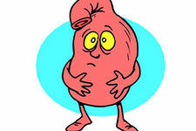
Bowel complaints
Pain
Flatulence
Diarrhea
Constipation

Slide 21
Bowel pain
Lack of strict connection with food intake (with the exception of inflammation of the transverse colon).
A close connection of pain with the act of defecation.
Relief of pain after defecation or gas discharge.

Slide 22
Bowel pain
Appendicular colic
Pain begins
near the navel and in
epigastric
areas then through
several hours
localized to
right iliac
area
Rectal colic
(tenesmus)
Frequent painful
urges without defecation,
sometimes with mucus.
Occur when
dysentery, proctitis
ulcers and cancer
rectum.

Slide 23
Flatulence - a feeling of bloating, painful fullness of the abdomen
Excessive dietary fiber
Obstruction and impaired intestinal motility
Excessive growth of gas-forming bacteria in the intestines
Lower intestinal wall gas absorption
Aerophagia
Hysteria

Slide 24
Diarrhea - a loose, unformed stool, combined with increased bowel movements
Development mechanism:
accelerated intestinal motility
malabsorption of digested food
intestinal inflammation
Causes:
intestinal infections
Intoxication
endocrine disorders
allergy

Slide 25
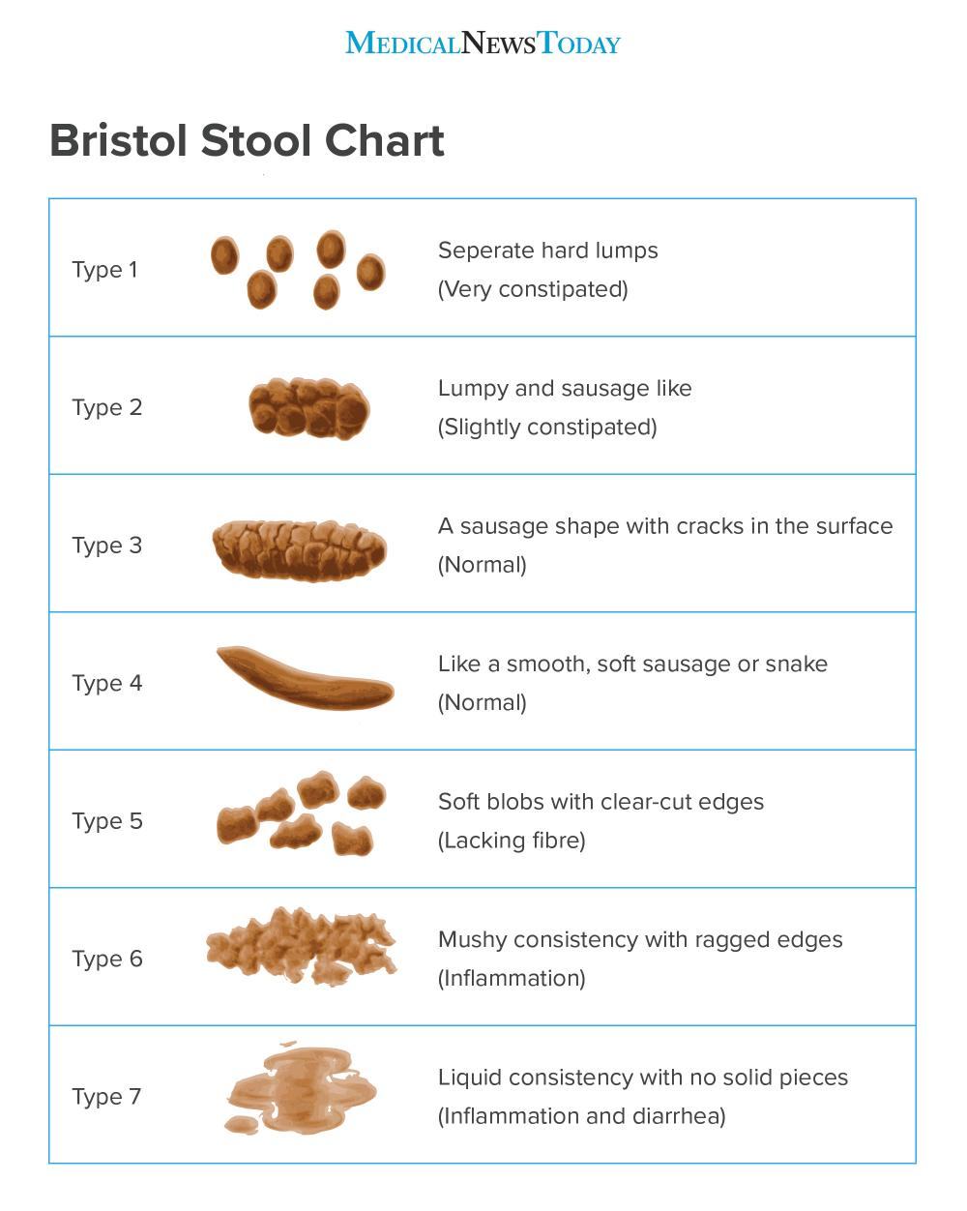

Slide 26
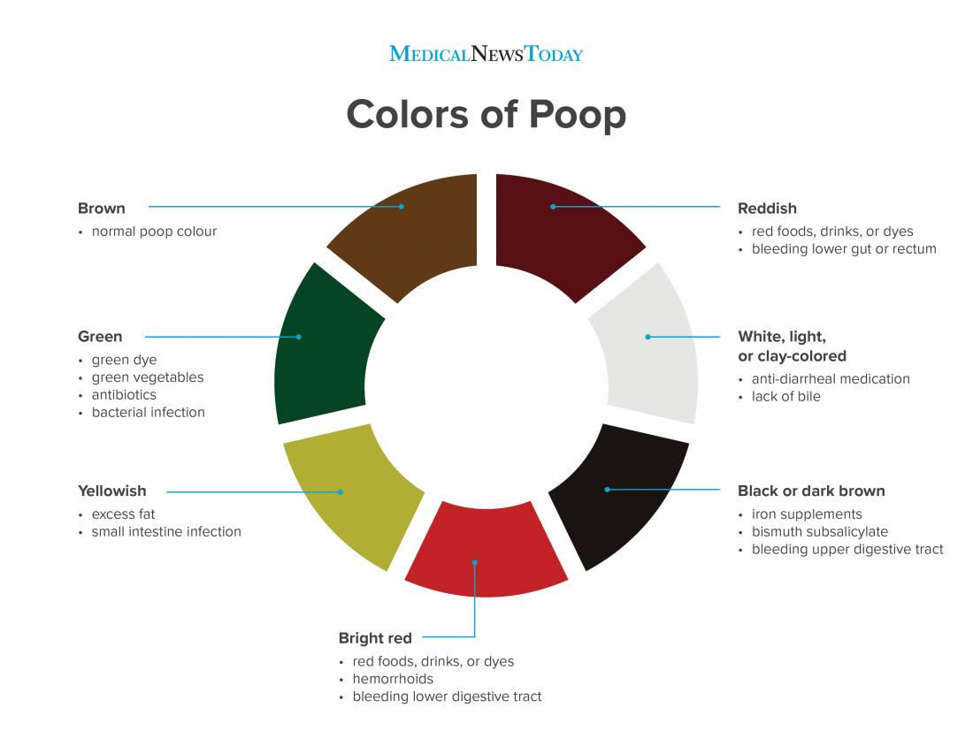

Slide 27
Constipation (Obstipatio) - prolonged retention of feces in the intestine
Organic Causes :
narrowing of the intestinal tract due to:
Tumors
scars,
adhesions
intestinal malformations
Functional Causes:
Alimentary
Neurogenic
Colon inflammation
Toxic
Endocrine
Hypodynamia
Abdominal weakness

Slide 28
History of gastrointestinal diseases
Medical history:
disease duration
causes and conditions of its occurrence
nature and dynamics of the course of the disease
Life story:
working and living conditions
nutritional conditions, rhythm of nutrition
previous gastrointestinal diseases, surgical interventions
long-term use of drugs (aspirin, corticosteroids, NSAIDs)
hereditary predisposition
bad habits (smoking, alcohol, etc.)
allergic history

Slide 29
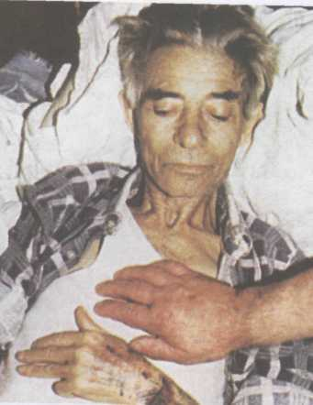
General examination
Losing weight even cachexia
- Esophageal carcinoma
- Stomach cancer
Intestinal malabsorption
Pallor of the skin
Gastric bleeding
Impaired iron absorption

Slide 30
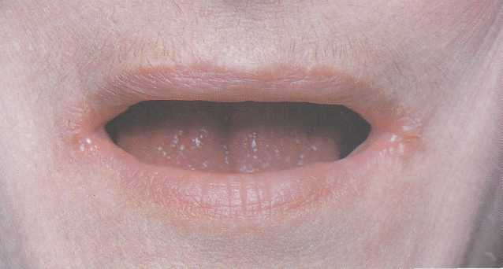
General examination
Dry skin, angular stomatitis
-
Violation of the absorption of vitamins in the digestive tract

Slide 31
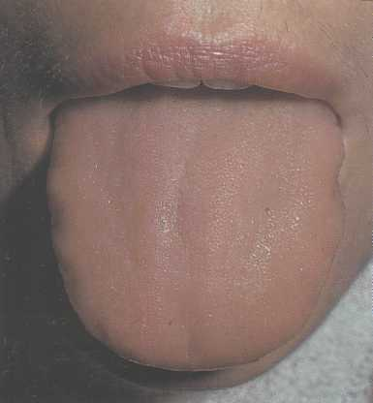
Examination of the oral cavity and tongue
Clean, moist tongue - uncomplicated peptic ulcer
Gray plated, smelling bad - acute gastritis

Slide 32
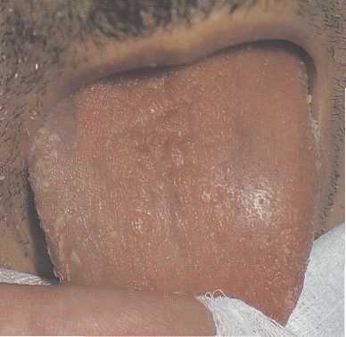
Examination of the oral cavity and tongue
Dry tongue
Acute belly
Pancreatitis

Slide 33
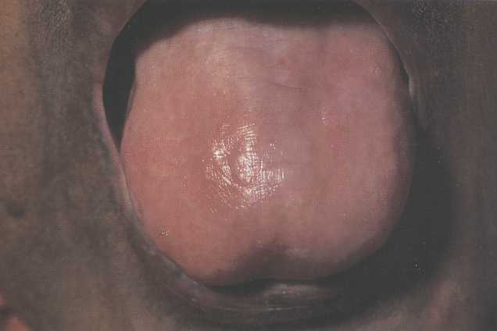
Examination of the oral cavity and tongue
Smooth tongue papillae
Stomach cancer
Atrophic gastritis with decreased secretory function
Vitamin B deficency

Slide 34
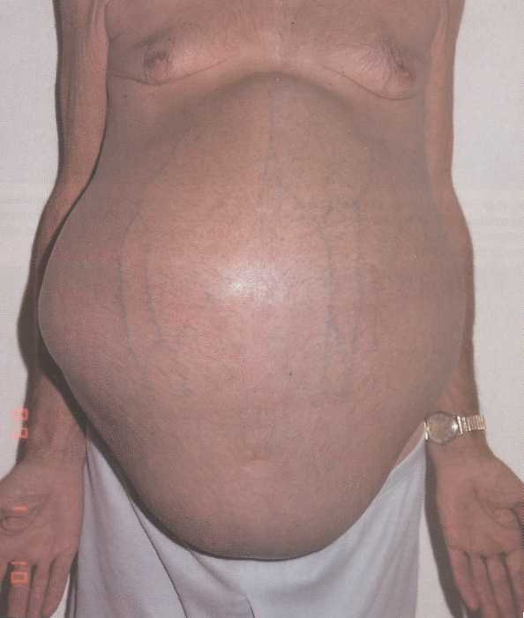
Abdominal examination
Abdominal wall limitation
- sign of pain
Visible peristalsis
- Pyloric stenosis
Bloating
- flatulence
- ascites

Slide 35

Palpation
Superficial indicative – light palpation
allows you to identify:
Local or general tension of the abdominal wall
Local or general soreness (cm Schetkina-Blumberg)
Divergence of the rectus abdominis muscles
Enlarged abdominal organs and the presence of tumors

Slide 36
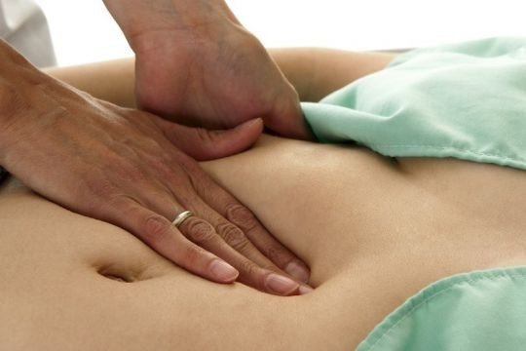
Palpation
Deep methodical sliding palpation according to the Obraztsov-Strazhesko method
allows you to get an idea about:
localization
sizes
consistency
soreness
mobility of the abdominal cavity organs

Slide 37
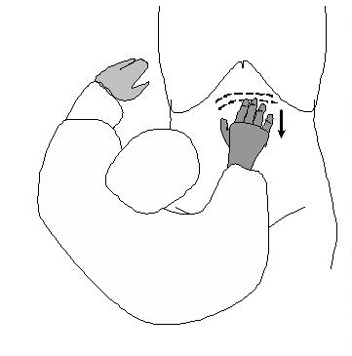
Palpation
Deep methodical sliding palpation according to the Obraztsov-Strazhesko method
Palpation objects
Stomach
Departments of the large and small intestines
Liver and gall bladder
Spleen

Slide 38
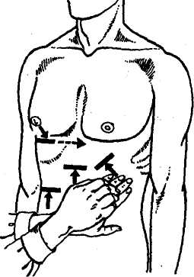
Percussion
Liver
Spleen
Percussion Tasks
1. Determination of the boundaries and sizes of the liver and spleen
2. Identification of free fluid in br. cavity (ascites)

Slide 39
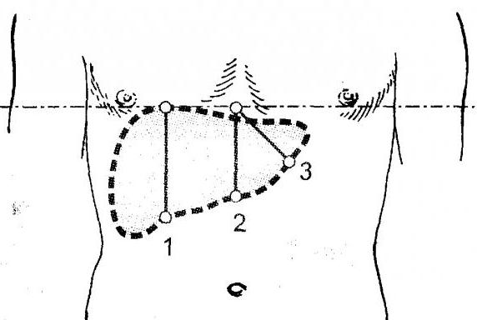
Percussion of liver by Kurlov
9 cm
8 cm
7 cm

Slide 40
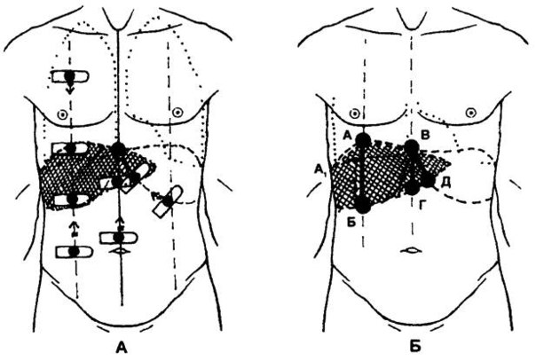

Slide 41


Slide 42


Slide 43
Auscultation of the abdomen – intestinal motility is heard
Increased peristalsis
Physiological - after eating, (plant fiber)
Small bowel inflammation
Bowel obstruction (early stage)
Weakening of peristalsis
Intestinal atony
Peritonitis,
bowel obstruction
("grave silence")

Slide 44
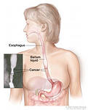
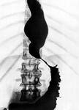
X-ray of the esophagus

Slide 45
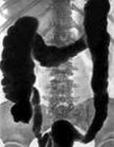
Normal X-ray of the colon

Slide 46
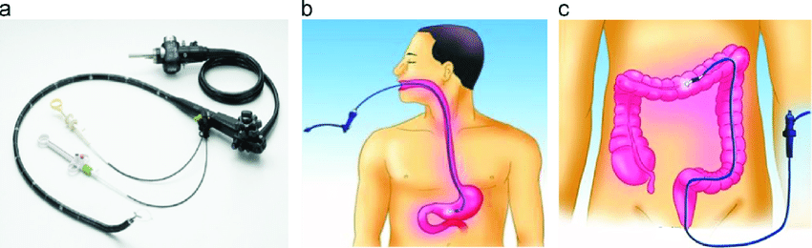
Endoscopic examinations

Slide 47
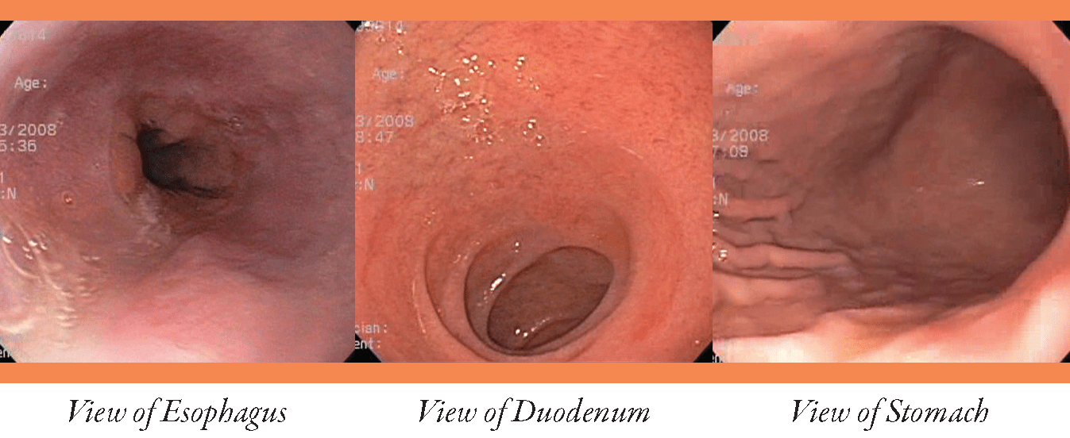

Slide 48
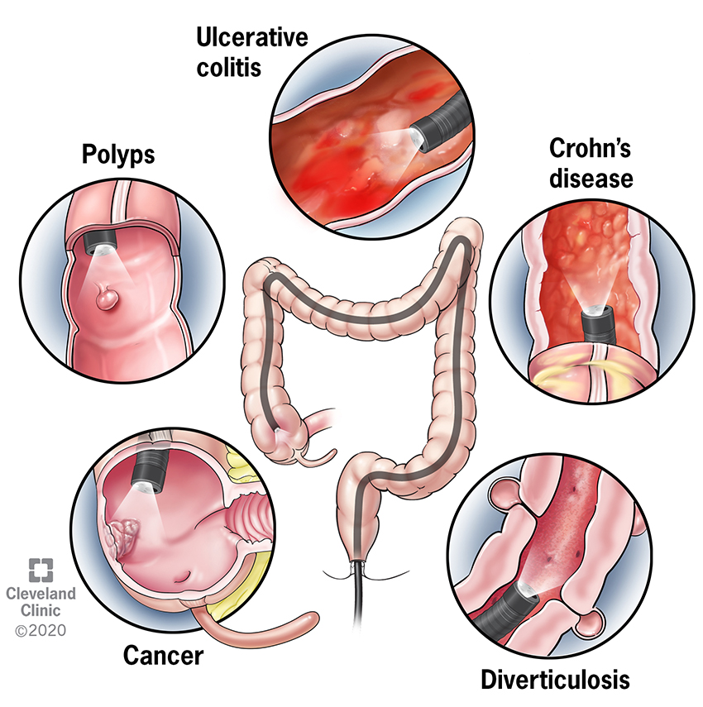
Colonoscopy

